Slide 1
Erika Hernandez
NET 4740
in
Class Presentation

Slide 2
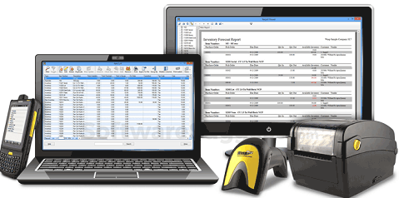
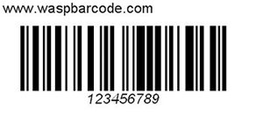

Basic 1- Inventory and Control Hardware Assets
Asset Owner
Asset Physical Location
Assigned assets department
Authorized devices
Controlling
Replacement

Slide 3
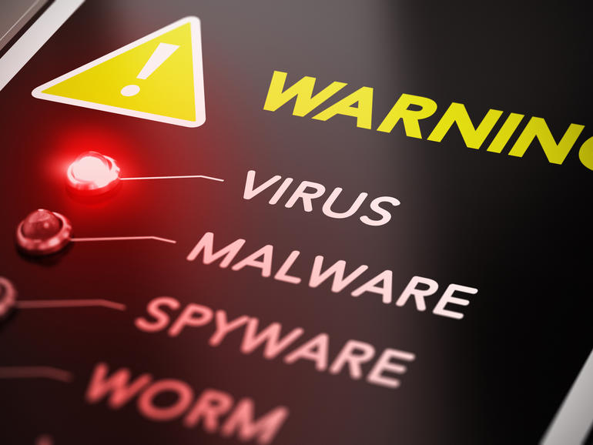
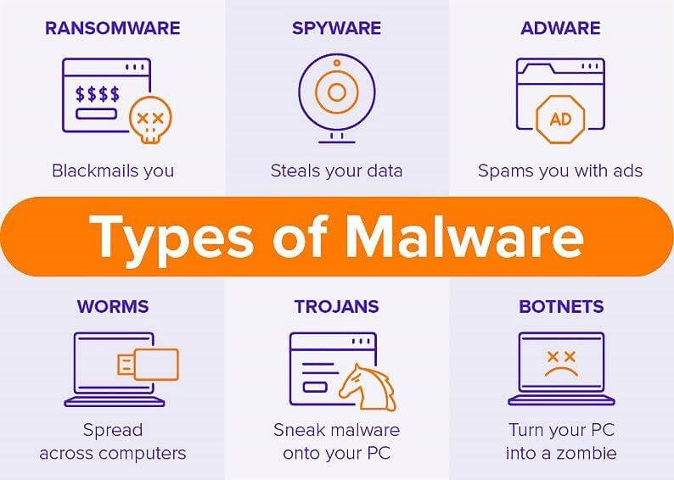
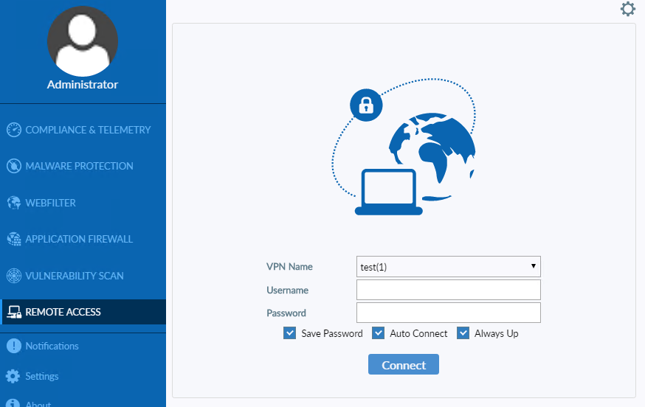
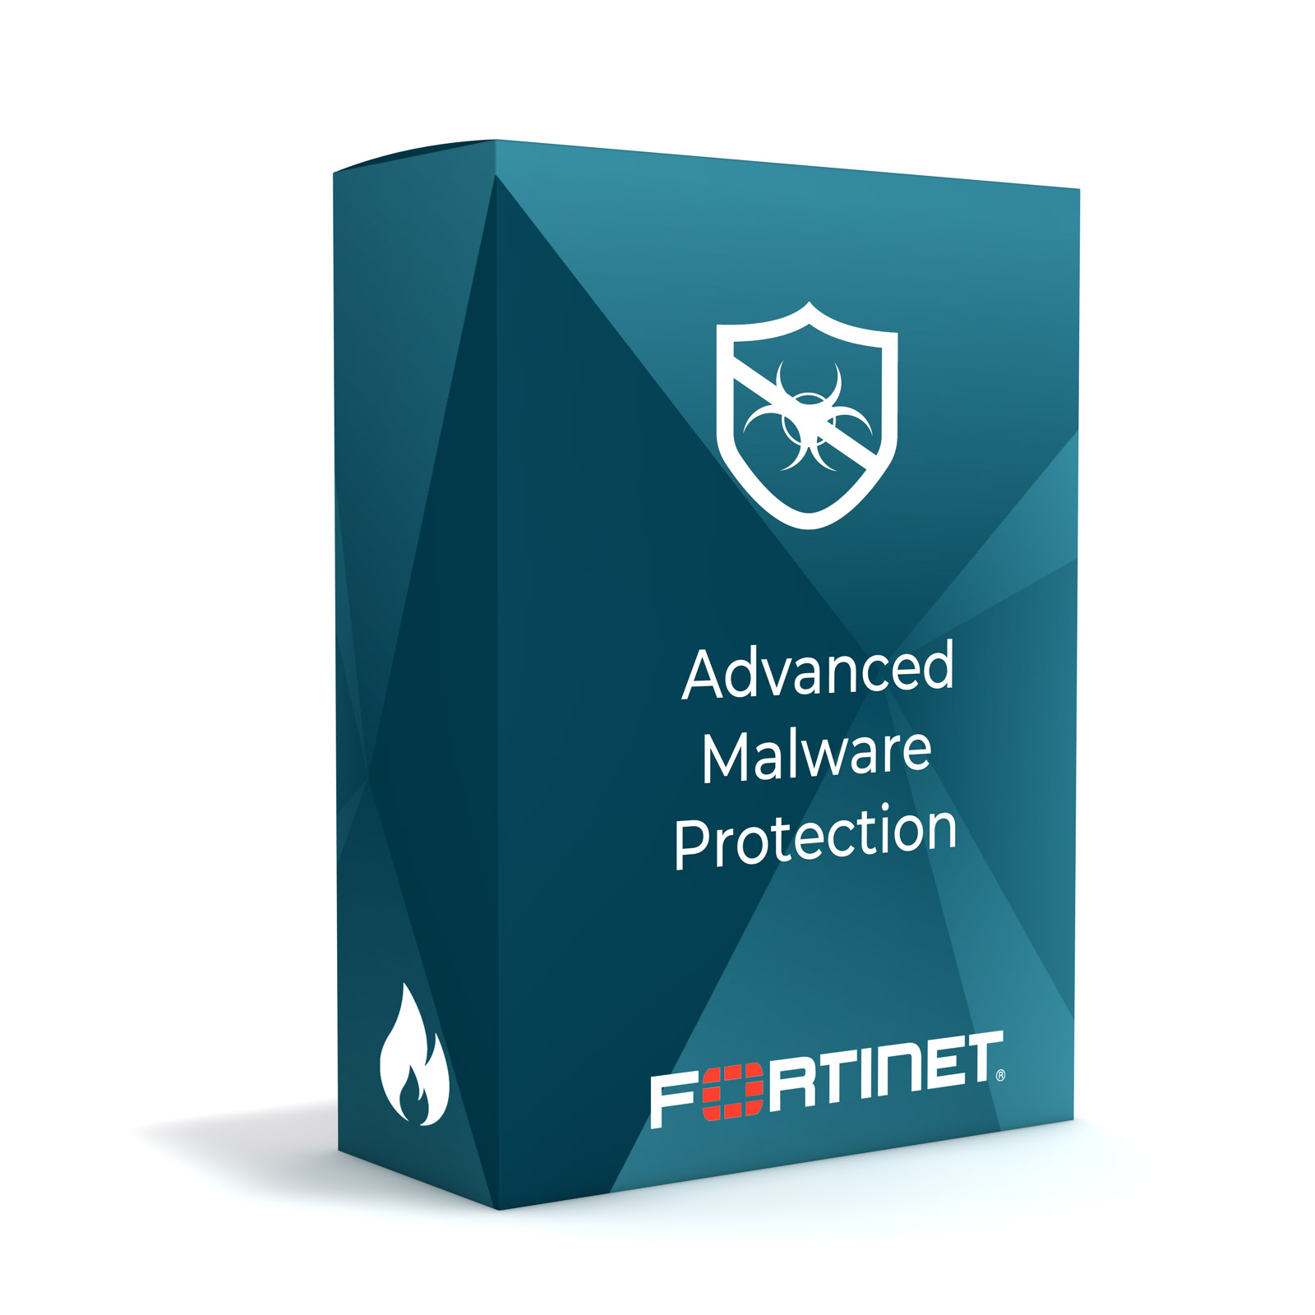
Foundational 8 - Malware Defense
Constantly Evolving
Can cost an organization money
Can enter at any points

Slide 4


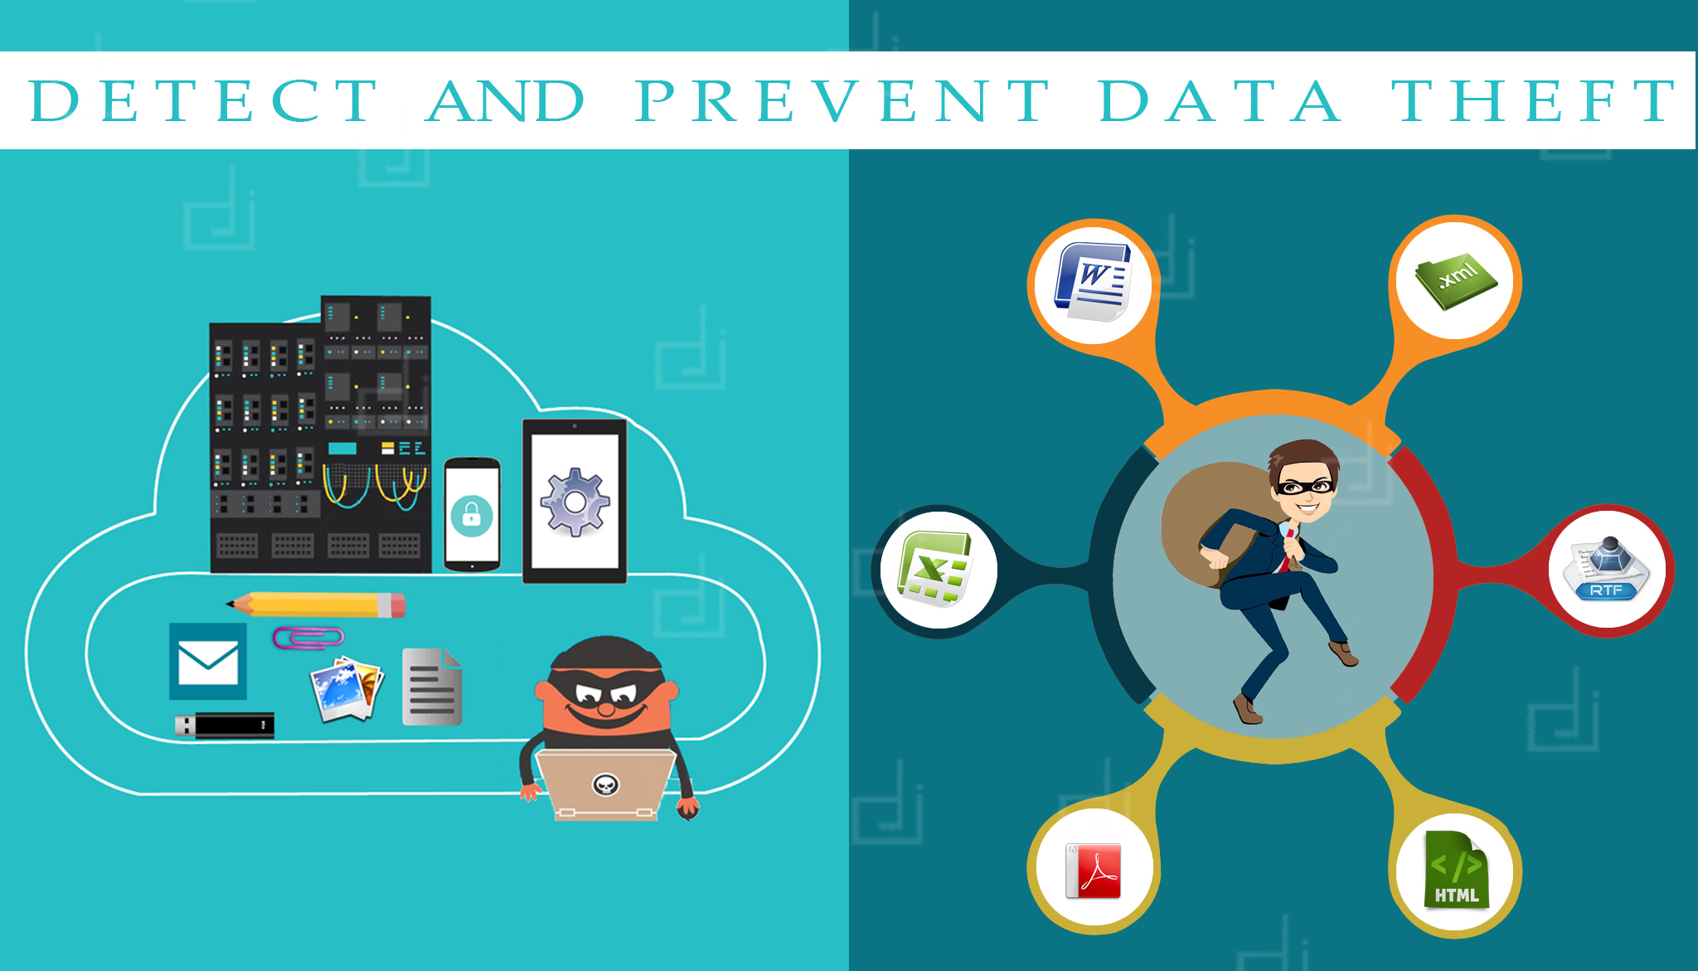
Foundational 13 - Data Protection
Data breach in 2021 in US $4.24 Million
Data protection is important
Mitigate the risk of data
Protect sensitive information

Slide 5

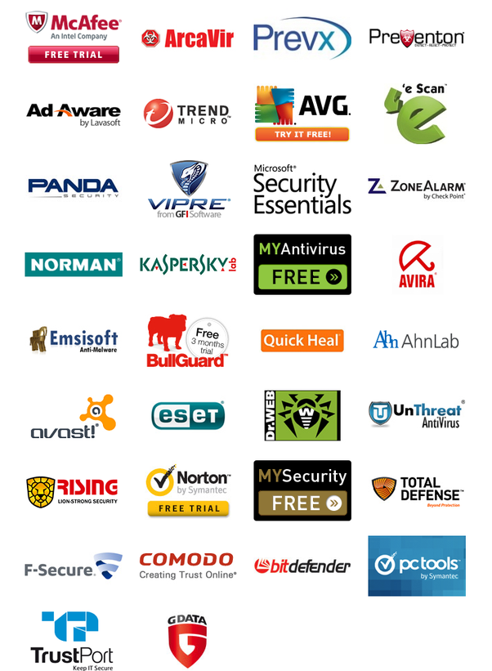
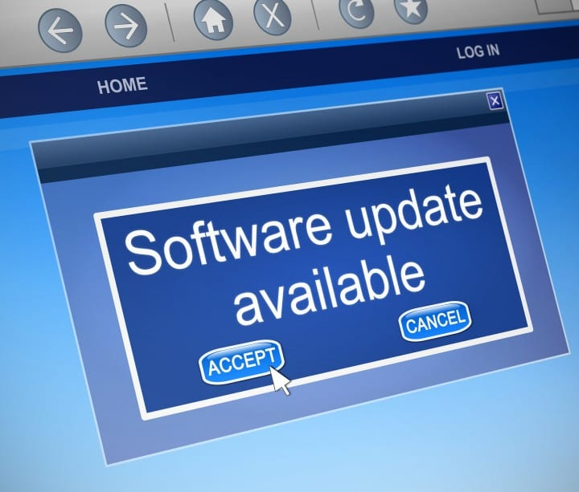

Organizational 19 – Application Software Security
Update software
Patching vulnerabilities
Mitigate attacks in the organization

Slide 6
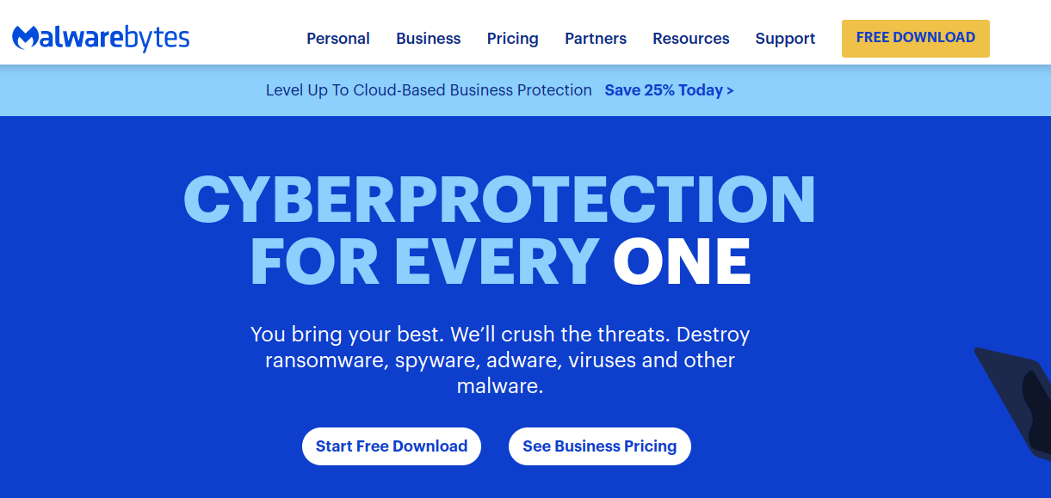
Implementation- Download Malware Software
https://www.malwarebytes.com/
Click on Download
Open File Manager
Double click on application installer .exe file
Download
Open Malwarebytes
Click on scan
Protected computer

Slide 7
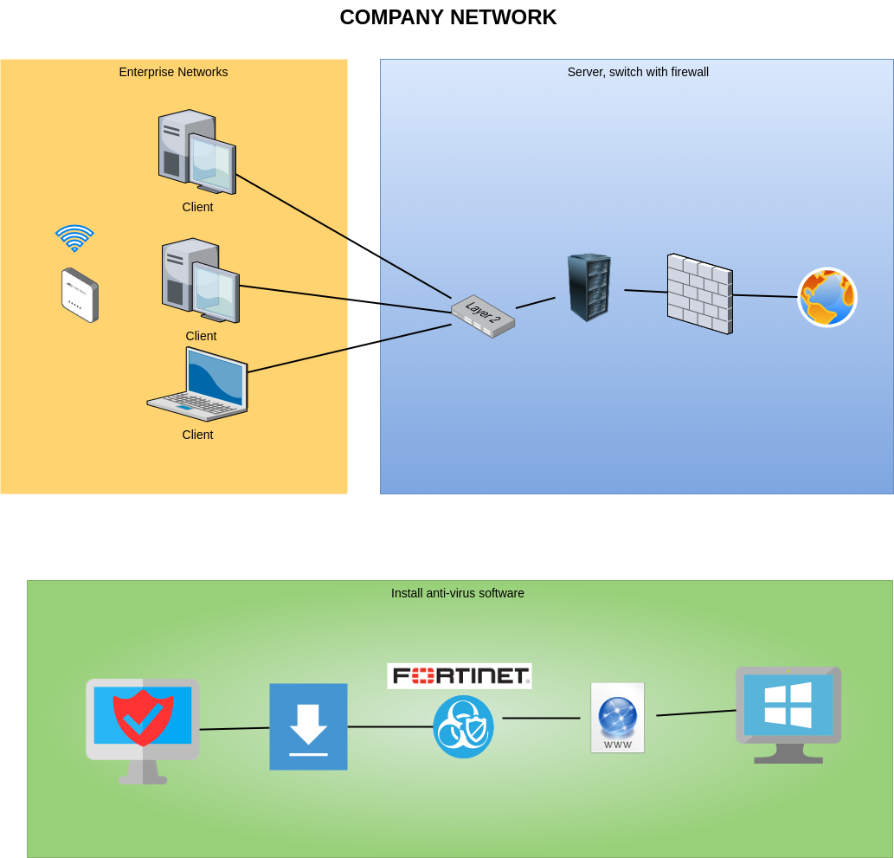
Implementation- Download Malware Software
Open File Manager
Double click on application installer .exe file
Download
Open FortiClient
Enter credentials
Protected computer

